Slide 1
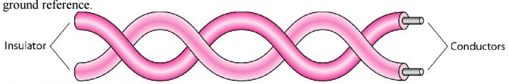
Guided media:
Guided media, which are those that provide a conduit from one device to another, include twisted-pair cable, coaxial cable, and fiber-optic cable. A signal traveling along any of these media is directed and contained by the physical limits of the medium. Twisted-pair and coaxial cable use metallic (copper) conductors that accept and transport signals in the form of electric current. Optical fiber is a cable that accepts and transports signals in the form of light.
1. Twisted-Pair Cable:-
A twisted pair consists of two conductors (normally copper), each with its own plastic insulation, twisted together.
One of the wires is used to carry signals to the receiver, and the other is used only as a ground reference.

Slide 2
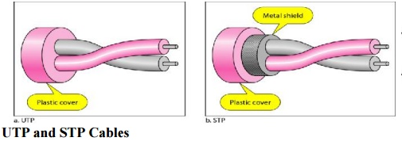
Unshielded Versus Shielded Twisted-Pair Cable
The most common twisted-pair cable used in communications is referred to as unshielded twisted-pair (UTP). IBM has also produced a version of twisted-pair cable for its use called shielded twisted-pair (STP). STP cable has a metal foil or braidedmesh covering that encases each pair of insulated conductors. Although metal casing improves the quality of cable by preventing the penetration of noise or crosstalk, it is bulkier and more expensive. Figure shows the difference between UTP and STP.

Slide 3
Unshielded Twisted Pair:
An unshielded twisted pair is widely used in telecommunication. Following are the categories of the unshielded twisted pair cable:
Category 1: Category 1 is used for telephone lines that have low-speed data.
Category 2: It can support upto 4Mbps.
Category 3: It can support upto 16Mbps.
Category 4: It can support upto 20Mbps. Therefore, it can be used for long-distance communication.
Category 5: It can support upto 200Mbps.
Advantages Of Unshielded Twisted Pair:
It is cheap.
Installation of the unshielded twisted pair is easy.
It can be used for high-speed LAN.
Disadvantage:
This cable can only be used for shorter distances because of attenuation.

Slide 4
Shielded Twisted Pair:-
A shielded twisted pair is a cable that contains the mesh surrounding the wire that allows the higher transmission rate.
Characteristics Of Shielded Twisted Pair:
The cost of the shielded twisted pair cable is not very high and not very low.
An installation of STP is easy.
It has higher capacity as compared to unshielded twisted pair cable.
It has a higher attenuation.
It is shielded that provides the higher data transmission rate.
Disadvantages
It is more expensive as compared to UTP and coaxial cable.
It has a higher attenuation rate.

Slide 5
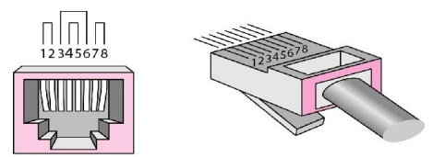
Connectors
The most common UTP connector is RJ45 (RJ stands for registered jack), as shown in Figure. The RJ45 is a keyed connector, meaning the connector can be inserted in only one way.
Applications
1. Twisted-pair cables are used in telephone lines.
2. TP used in telephone network.
3. In LAN, TP wires are mainly used for low cost, low performance applications.

Slide 6
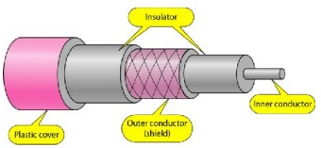
2. Coaxial cable:
Coaxial cable (or coax) carries signals of higher frequency ranges than those in twisted pair cable. It has a central core conductor of solid or stranded wire (usually copper) enclosed in an insulating sheath, which is, in turn, encased in an outer conductor of metal foil, braid, or a combination of the two. The outer conductor is also enclosed in an insulating sheath, and the whole cable is protected by a plastic cover (see Figure).

Slide 7
Coaxial cable is very commonly used transmission media, for example, TV wire is usually a coaxial cable.
The name of the cable is coaxial as it contains two conductors parallel to each other.
It has a higher frequency as compared to Twisted pair cable.
The inner conductor of the coaxial cable is made up of copper, and the outer conductor is made up of copper mesh. The middle core is made up of non-conductive cover that separates the inner conductor from the outer conductor.
The middle core is responsible for the data transferring whereas the copper mesh prevents from the EMI(Electromagnetic interference).
Coaxial cable is of two types:
Baseband transmission: It is defined as the process of transmitting a single signal at high speed.
Broadband transmission: It is defined as the process of transmitting multiple signals simultaneously.
Advantages Of Coaxial cable:
The data can be transmitted at high speed.
It has better shielding as compared to twisted pair cable.
It provides higher bandwidth.
Disadvantages Of Coaxial cable:
It is more expensive as compared to twisted pair cable.
If any fault occurs in the cable causes the failure in the entire network.

Slide 8
Applications:-
· Coaxial cable was widely used for both analog and digital data transmission.
· It has higher bandwidth.
· Inexpensive when compared to fiber optical cables.
· It uses for longer distances at higher data rates.
· Excellent noise immunity
· Used in LAN and Television distribution.

Slide 9
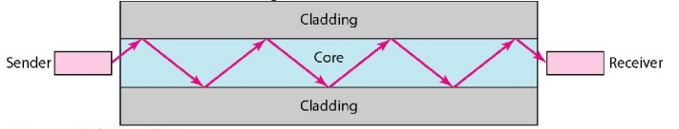
3. Fiber-Optic Cable:
A fiber-optic cable is made of glass or plastic and transmits signals in the form of light. Light travels in a straight line as long as it is moving through a single uniform substance. If a ray of light traveling through one substance suddenly enters another substance, then the ray changes direction.
Optical fibers use reflection to guide light through a channel. A glass or plastic core is surrounded by a cladding of less dense glass or plastic. The difference in density of the two materials must be such that a beam of light moving through the core is reflected off the cladding instead of being refracted into it.
Basic elements of Fibre optic cable:
Core: The optical fibre consists of a narrow strand of glass or plastic known as a core. A core is a light transmission area of the fibre. The more the area of the core, the more light will be transmitted into the fibre.
Cladding: The concentric layer of glass is known as cladding. The main functionality of the cladding is to provide the lower refractive index at the core interface as to cause the reflection within the core so that the light waves are transmitted through the fibre.
Jacket: The protective coating consisting of plastic is known as a jacket. The main purpose of a jacket is to preserve the fibre strength, absorb shock and extra fibre protection.

Slide 10
Applications
Fiber-optic cable is often found in backbone networks because its wide bandwidth is cost-effective. Today, with wavelength-division multiplexing (WDM), we can transfer data at a rate of 1600 Gbps.
Some cable TV companies use a combination of optical fiber and coaxial cable, thus creating a hybrid network. Optical fiber provides the backbone structure while coaxial cable provides the connection to the user premises. This is a cost-effective configuration since the narrow bandwidth requirement at the user end does not justify the use of optical fiber. Local-area networks such as 100Base-FX network (Fast Ethernet) and 1000Base-X also use fiber-optic cable.

Slide 11
Advantages of Optical Fiber:
Fiber-optic cable has several advantages over metallic cable (twisted pair or coaxial).
· Higher bandwidth.
· Less signal attenuation.
· Immunity to electromagnetic interference.
· Resistance to corrosive materials.
· Light weight.
· Greater immunity to tapping.
Disadvantages of Optical Fiber:
There are some disadvantages in the use of optical fiber.
· Installation and maintenance.
· Unidirectional light propagation.
· Cost.

